Slide 1
OSU Model Enhancements
TPAU On-Call Services Call

Slide 2
New Model Components
Faculty\Staff Travel Models
Residential location choice
Travel models (work tour gen, scheduling, mode, stops, etc.)
Only tours to/from campus
Parking location choice model
Parking supply constraints
Lot -> campus mode choice

Slide 3
Faculty\Staff Residential Location Choice & Worker Selection Model
Aggregate workers in synthetic population in relevant occupation categories by TAZ for size terms
Size_{i} = ∑workers_{i}
Calculate aggregate probabilities (distance-based accessibilities)
Prob_{i} = e^{Utilij + Sizei}
3. Worker selection; For each faculty\staff
Choose residence TAZ according to probability
Choose worker at random from synthetic population in residence TAZ
If worker already selected, re-choose

Slide 4
Faculty\Staff Travel Models
Assume 85% work tour/worker rate
Typically 80-85% of workers go to work on any given day
Use mode choice models developed for UofO University Tours
Use student scheduling model or develop schedules from UofO data
Use student stop frequency models or generate stops from UofO data
Use university tour stop location choice model

Slide 5
Parking Location Choice: Dimensions
Util_{m,l1,D}
Campus Destination TAZ (D)
Lot TAZ 1
(l₁)
Util_{m,O,} _{l1}
Tour Origin
TAZ (O)
Util_{l1,t}
Util_{m,l2,D}
Util_{m,O,} _{l2}
Lot TAZ 2
(l₂)
Util_{m,l3,D}
Util_{m,O,} _{l3}
Util_{l2,t}
Lot TAZ 3
(l₃)
Util_{m,O,} _{ln}= Utility from origin to lot n (by auto modes m∩a)
Util_{m,ln,D} = Utility from lot n to campus (by non-auto modes m/a)
Util _{ln ,t} = Utility of lot n at time t (capacity, availability)
m = modes
a = auto modes (6: drive-alone, shared-2, shared 3+ by free, toll)
m/a = non-auto modes (walk, walk-transit)
O = university tour origin (home) TAZ
D = university tour primary destination (campus) TAZ
Util_{l3,t}

Slide 6
Parking Location Choice
Option | Description | Pros | Cons
A | 1. Choose mode 2. Choose lot location for auto tours 3. Choose non-auto mode from lot to campus | Computationally tractable | No sensitivity of mode choice to lot capacity or transit service from lot to campus
B | 1. Choose mode and lot simultaneously, using full modal utilities for each tour | Mode choice sensitivity to lot capacity and transit service from lot to campus. Sensitivity to all user attributes in consistent choice | Computational burden; iterate through all lots for each tour to campus calculating full modal utilities
C | Choose lot location based upon simplified modal utilities Recalculate mode using full modal utilities | Mode choice sensitivity to lot capacity and transit service from lot to campus. Computational efficiency | Lot location choice does not take into account all user attributes consistently
Notes:
Why not choose lot after mode choice?
Want parking capacity, price to affect mode choice
As close-by lots fill up, more people park in satellite lots, makes driving utility worse
There are xx TAZs with parking on campus
That means that mode choice calculations would be multiplied by xx

Slide 7
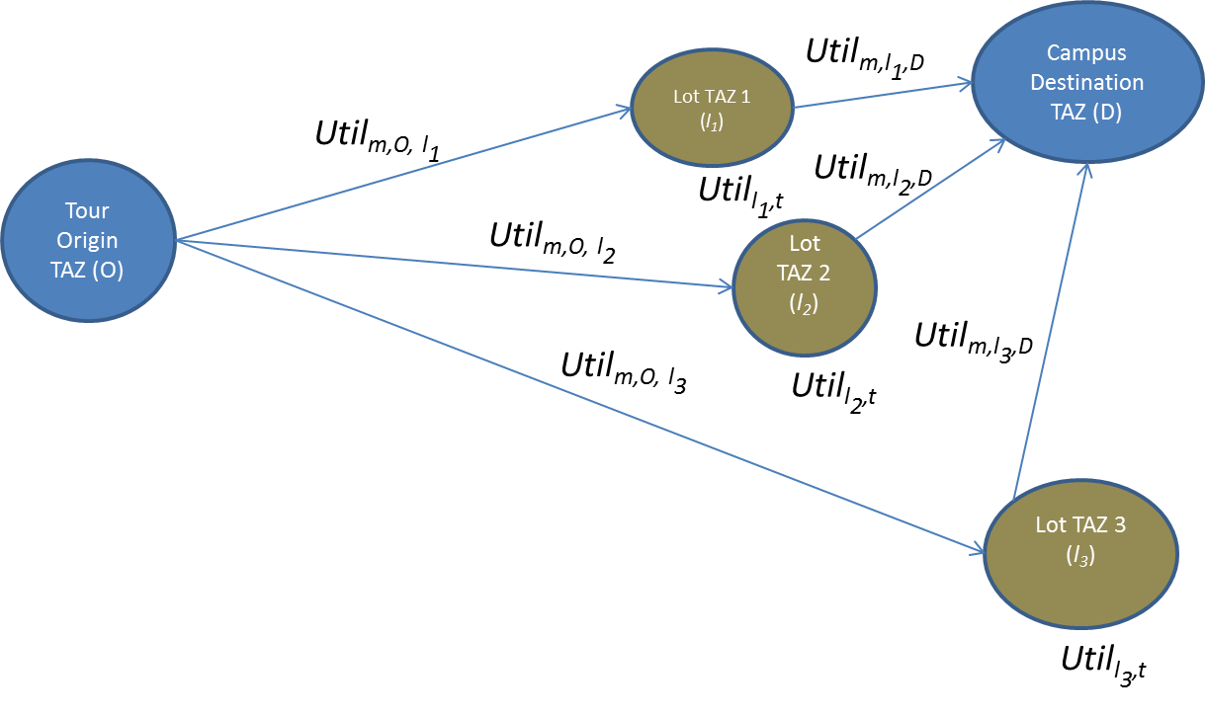
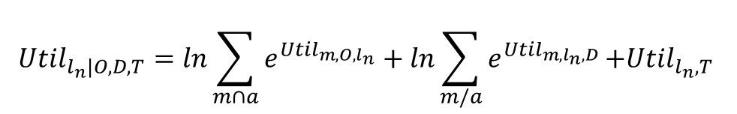
Parking Location Choice
Utility from lot to
Campus by walk, transit
$${Util}_{l_{n}|O,D,T}=ln\sum_{m∩a}{e^{{Util}_{m,O,l_{n}}}+ln\sum_{m/a}{e^{{Util}_{m, l_{n},D}}}\text{+}{Util}_{l_{n},T} }$$
Utility from origin
to lot by auto modes
Utility of lot

